Slide 1
Charity Management System
Submitted by:
Bhagyashri Bhamare (181IT111)
C Sneha (181IT112)
Priyanka B. G. (181IT135)

Slide 2
Agenda
I.Introduction
II.Literature Survey
III.Outcome of Literature Survey
IV.Motivation
V.Problem Statement
VI.Proposed Model
VII.Methodology
VIII.Proposed modifications
IX.Work done
X.Results and analysis
VIII.Timeline of Project
IX.Individual Contribution
X.References

Slide 3
Introduction
A majority of NGOs have experienced difficulties in getting funds or other required things as donations. Getting a donor is a very hard task, and sometimes dealing with some donor’s conditions can be a big challenge for NGOs to fulfil it.This website for charity management system will help NGOs to find donors easily and make raising funds hassle free. We have used html, css, javascript, nodejs, expressjs and mysql for the creation of this website.
This system involved in the website has five modules namely, Admin, Bank, Medicine Donation, Money Donation and Fund for NGO.

Slide 4
Outcome of Literature Review
Proper design has become a critical element needed to engage website and mobile application users. However, little research has been conducted to define the specific elements used in effective website application design. We attempt to review and consolidate research on effective design and to define a short list of elements frequently used in research. The design elements mentioned most frequently in the reviewed literature were navigation, graphical representation, organization, content utility, purpose, simplicity, and readability. We discuss how previous studies define and evaluate these seven elements. This review and the resulting short list of design elements may be used to help designers and researchers to operationalize best practices for facilitating and predicting user engagement.

Slide 5
Literature survey
Authors | Title | Advantages | Limitations
Sally McDonald, Alice Fabbri, Lisa Parker, Jane Williams, LIsa Bero | Medical donations are not always free:an assessment of compliance of medicine and medical device donations with World Health Organization guidelines(2009-2017) | Analysis of donation patterns and how it can improve the quality of life for some. | Difficult to coordinate on such a huge scale
Rainahul Kabir, Subrata Talapatra, Akash Shinga Bappy | Online Charity Management System | NGOs will get donors easily. Donor can donate few things to needy people just by sitting at home. | It needs active internet connection.

Slide 6
Issues and Challenges
Authentication for the admin.
Connecting the frontend to backend.
Correcting the errors occurred accidentally while working for a desired result.
Integrating the modules.

Slide 7
Motivation
The motivation behind this project is to resolve the issues faced by the NGOs as majority of NGOs find it difficult to raise funds and also the unused medicines from people who want to donate it but don’t know how and where. This made us think of an idea to come up with a portal where the donors can register themselves to donate the medicines/funds and the NGOs can request for donations when required. As some NGOs may fake their identity/reality we have admin to check the correctness of the NGO who has requested and then accept or reject the request.

Slide 8
Problem Statement
To design a charity management website in order to help majority of NGOs which experience difficulties in getting funds or which specially take unused medicines donated to give to the needy. This website allows NGOs to collaborate with the admin of the website to procure funds and donations. Moreover, the user can donate unused medicines or cash funds through the website. The donations are then circulated to the NGOs when requested.

Slide 9
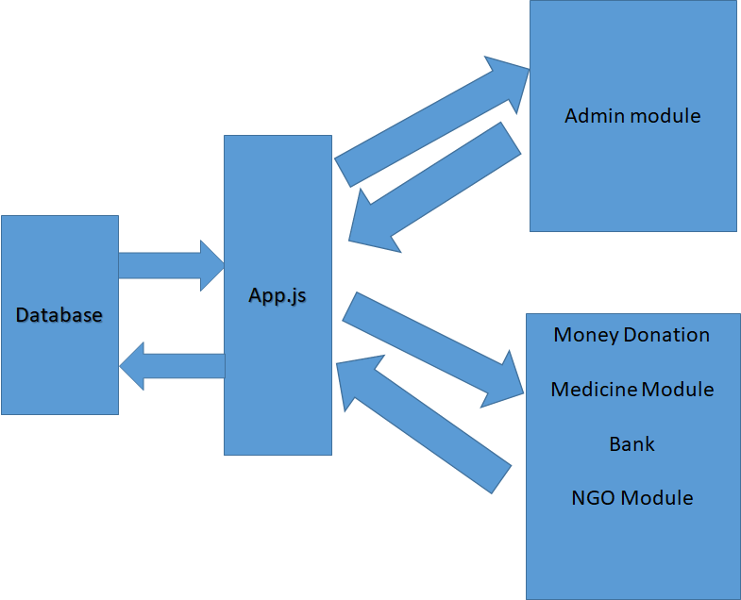
Proposed Model

Slide 10
Methodology
Admin Module
Admin can login to this module using an assigned username and password. The admin then has access to manage the monetary funds as well as the donated medicines. He can also send request for donations to previous money donors. Admin is also incharge of selecting NGOs to collaborate with by approving or rejecting a NGO’s request.
Bank Module
User can search medicine donor for medicine or illness type in the medicine bank. Donors contact details will displayed who want to donate the medicine needed.

Slide 11
Medicine Donation Module
Any medicine donor can donate medicine by providing his contact details. Medicine whose expiry date is gone will automatically be removed from the database.
Money donation Module
Any money donor can donate money by providing the correct information. All the fields in the money donation form are necessary to be filled.The values of fields like card number, cvv and expiry date are validated. After the donation the donor is sent an email thanking them using the nodemailer module.
Ngo Module
Ngo can request for funds by providing information about them. The decision is taken by the admin if they are eligible for a fund and a response in sent through an email.

Slide 12
Requirements analysis:
Front-end: html, CSS, ejs templates
Backend: nodejs, expressjs, MySQL connectors.
Database: MySQL

Slide 13
Proposed modifications
The application, although completely usable in its current state, could use the following few refinements and future developments:
Create a separate portion of the webpage for donors forums, FAQs and blog posts, to engage and promote user interactivity.
Integrate a chat application with the purpose of providing answers to basic questions posed by the user regarding process of donation etc.
Create a new module for delivery and pickup of medicine donations.

Slide 14
Work Done
Implemented the login module and admin where admin can accept or reject the NGO and monitor the funds and donations made.
Bank module to search for the available medicines with donor details
Medicine Donation Module for a donor to donate medicine with its details where the expired medicine will be deleted from the database automatically.
Money donation module for a donor to donate money.
NGO Module for the NGO to request for funds which will later be accepted or deleted by the admin.

Slide 15
Results and Analysis
The web application works as planned. Helpify is a website that lets an admin overlook the donations made and channel them to the needy. And those who have an excess of a medicine can donate them instead of it going to waste. People can also make monetary donations. These funds can then be given to NGOs that are collaborating with the admin.
In this world where some people don’t even have enough resources to take the needed medications this website could be a game changer.

Slide 16
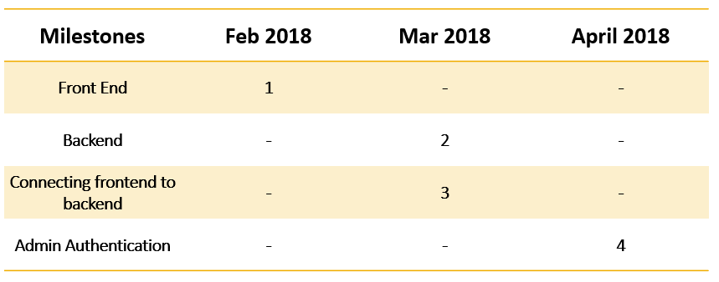
Time Line of Project

Slide 17
Individual Contribution
Bhagyashri Bhamare -backend end (app.js), frontend end-bank-NGO request page,Database
C Sneha -backend end(app.js),Front end-Money Donation, NGO request, Medicine Donation
Priyanka B. G. -backend end (app.js), Front-end Admin login, Admin Index page, Request to Money Donor, Medicine donor Information

Slide 18
References
https://www.w3schools.com/css/
https://www.w3schools.com/nodejs/nodejs_mysql.asp
https://www.w3schools.com/js
https://www.w3schools.com/nodejs/

